Slide 1

REEF CHECK TARGET FISHES
🐟
🐟
🐟
🐟
🐟
🐟
🐟
🐟
🐟
🐟
Notes:
Eureka Amadea
May 2018

Slide 2

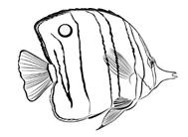
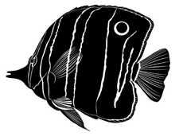
TARGET FAMILIES
Groupers
Barramundi Cod
Sweetlips
Snappers
Butterflyfish
Humphead Wrasse
Parrotfish
Bumphead Parrotfish
Moray Eels

Slide 3
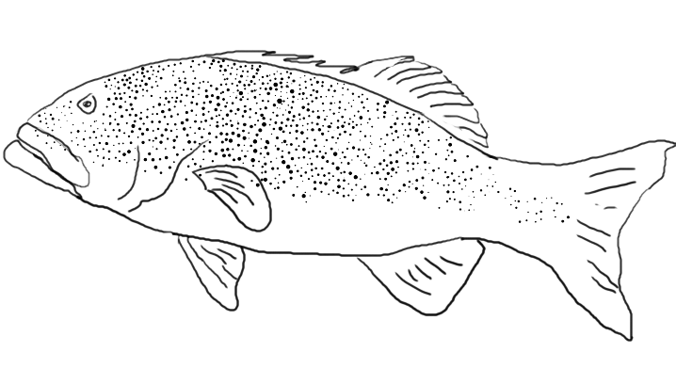
HOW TO IDENTIFY A FISH
Morphology
  Shape of the head, body, mouth, fins and tail
  Markings and patterns
  Color (might differ between juvenile and adult)
How it swims
  Continuously
  Stop start motion
Where it stays in the water column?
  High in the water column
  Near the bottom
Interorbital region
Dorsal fin (and spines)
Eye
Upper jaw
Caudal peduncle
Lower jaw (mandible)
Caudal fin
Suborbital region
Pectoral fin
Pelvic fin
Anal fin
Operculum (gill cover)
Gill opening

Slide 4
HOW TO RECOGNIZE THE TARGETS

Slide 5
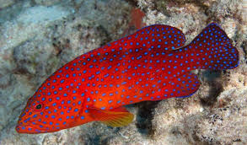
GROUPERS
Some have distinctive spines on their dorsal (top) fin
Ambush predators → usually wait motionless on top of corals
Eyes at the top of the head, close to the mouth
Wedge-shaped tail
Protruding lower jaw
Often have spots
Bottom dwellers → flat underside
Count only individuals over 30cm!

Slide 6
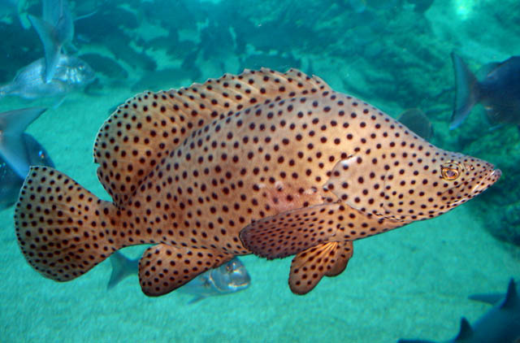
BARRAMUNDI COD
Flattened head followed by a hump
Very shy so will likely hide under corals and rocks
Swim with pectoral fins

Slide 7
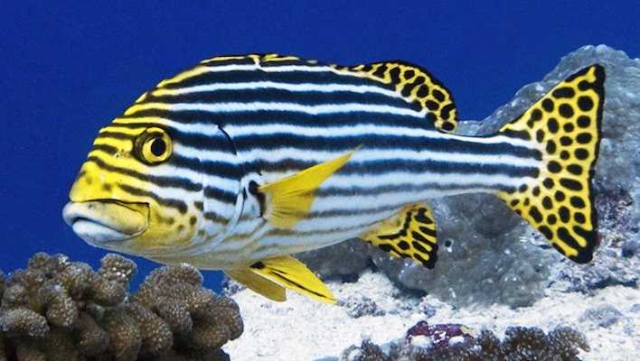
SWEETLIPS
Thicker body than a grouper
Upper lip thicker and protrudes over the bottom
Low set mouths with thick lips!
Often have spots and stripes patterns

Slide 8
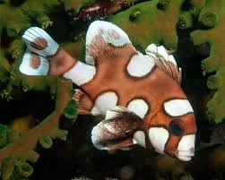
Watch out for this one…
Manyspotted Sweetlips - Juvenile
Juveniles can often vary greatly in their appearances from their adult forms

Slide 9
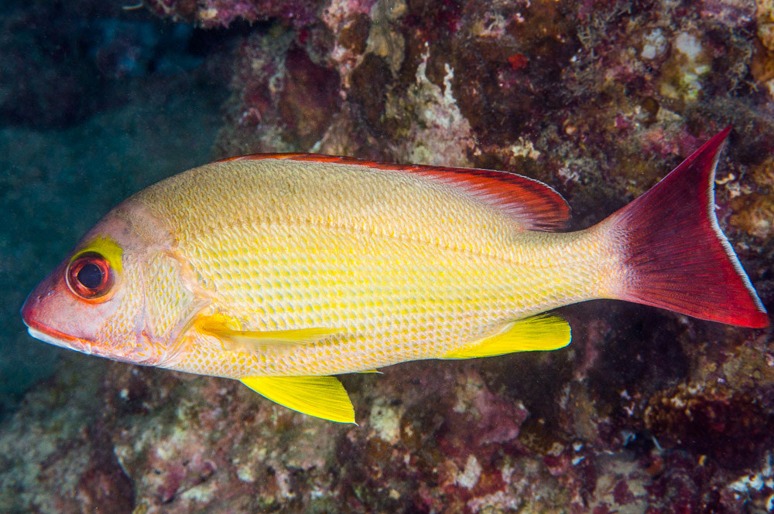
SNAPPERS
Shallow sloping forehead
Not symmetrical about the middle line
Angular shape of head
Move continuously
Often found in large schools
Usually in mid-water
Thin lips

Slide 10
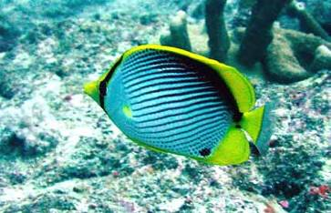
BUTTERFLYFISH
Small, disc-shaped, laterally compressed or triangular
Small protruding mouth
Often bright yellow, black, and white colours
Very small gap between tail and rear fins
Often move in pairs

Slide 11
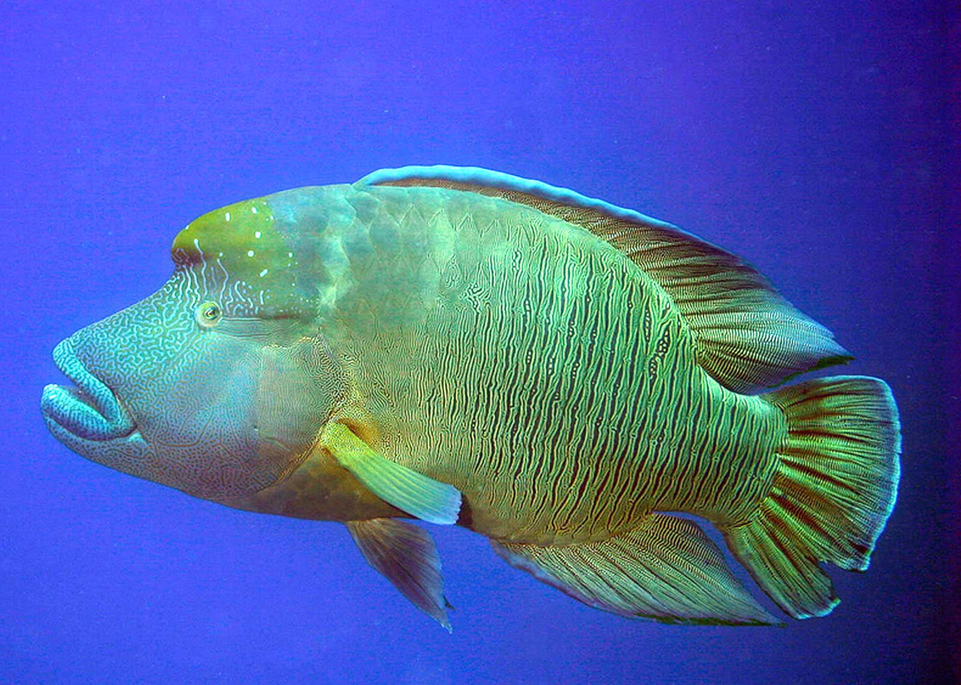
HUMPHEAD WRASSE
HUGE fish!!
Hump on their forehead
Eyes can move independently
Thickened lips
Off-transect sighting included!!

Slide 12
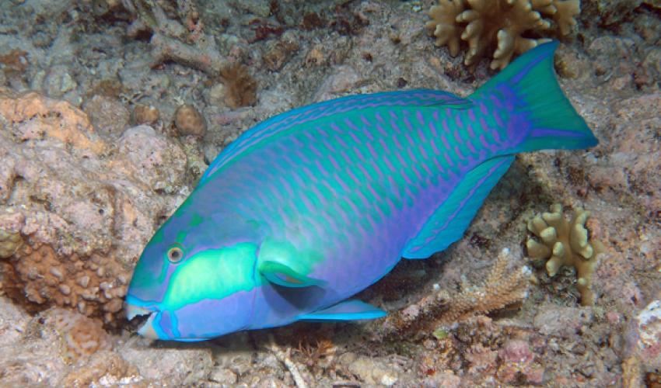
PARROTFISH
Large scales
Often green with blue and pink marks – colorful!
Swim with pectoral fins
Fused teeth form a beak – you can’t get the mouth wrong!
Only count those above 20cm!!

Slide 13
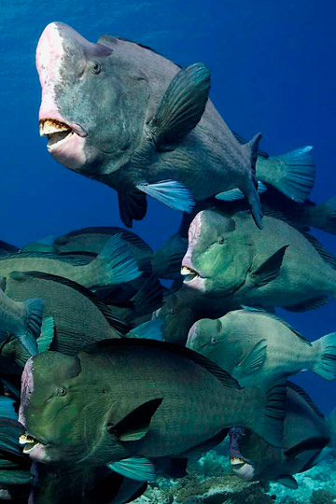
BUMPHEAD PARROTFISH
VERY LARGE
Also has a “beak” instead of teeth
Typically feed in schools
Large bump!
Off-transect sighting included!!

Slide 14
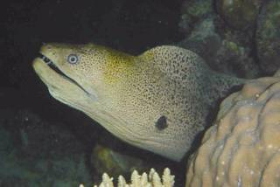
MORAY EELS
Hide in holes
Often still with their mouths open

Slide 15
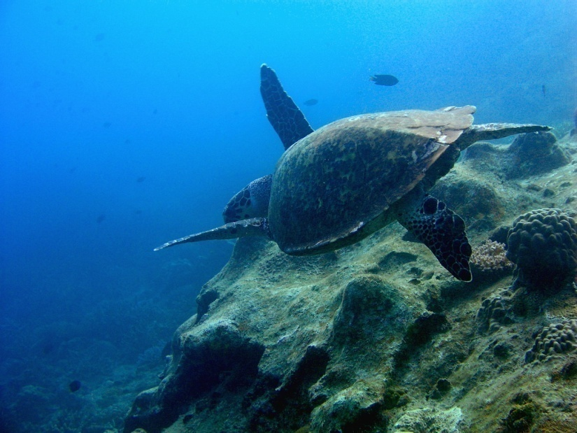
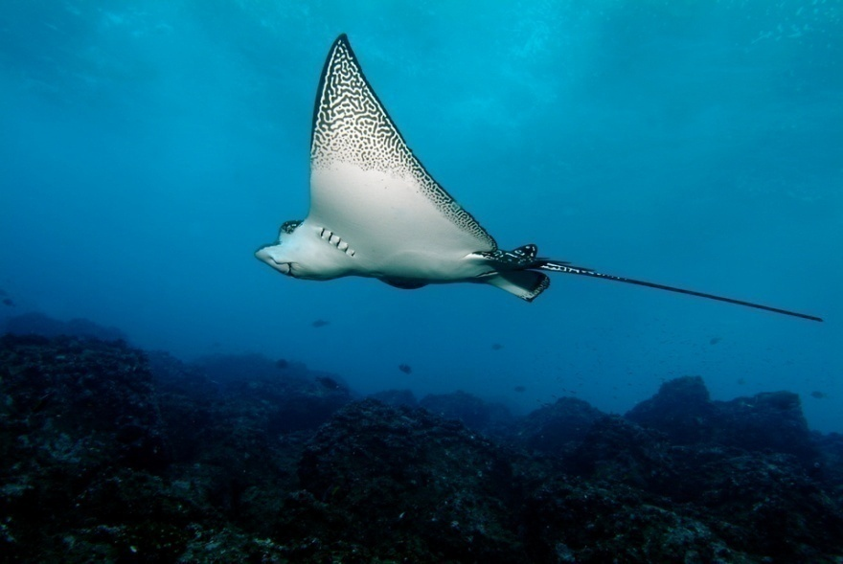
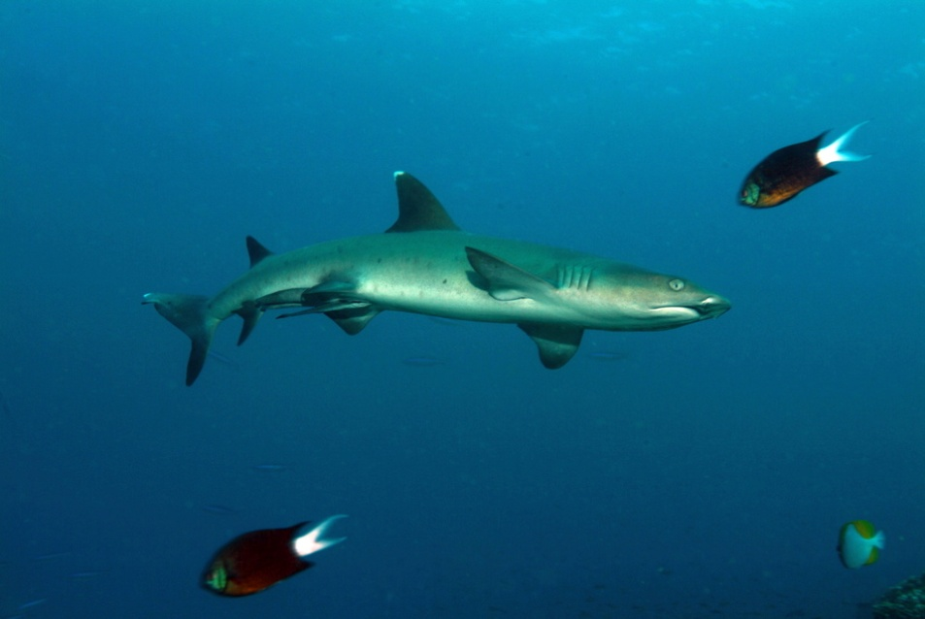
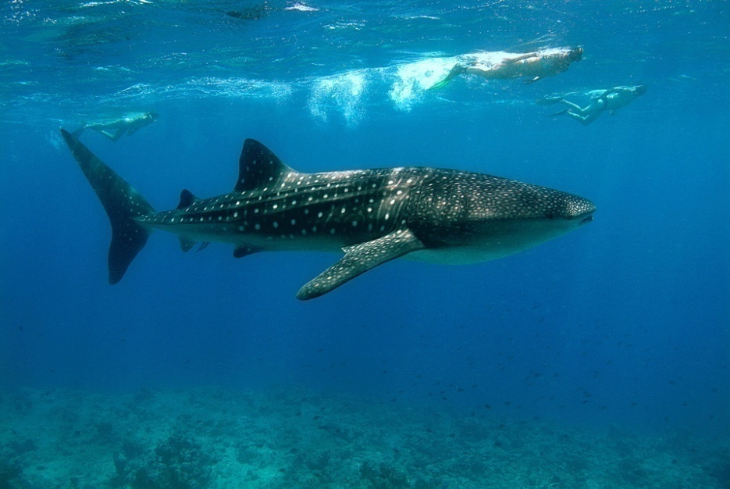
RARE ANIMALS
Note anything rare even if off-transect

Slide 16
STUDY WELL…
We will answer further questions you have on camp ☺
AND SEE YOU SOON! ☺

