Slide 1


REEF CHECK INVERTEBRATES
Notes:
By Eureka Amadea
June 2018

Slide 2


TARGET INVERTS
Banded Coral Shrimp
Diadema Urchin
Pencil Urchin
Sea Cucumbers
Crown-of-Thorns
Giant Clam
Triton Shell
Lobster

Slide 3

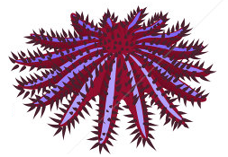
IDENTIFYING INVERTEBRATES
Reef Check target invertebrates are distinctive and easy to identify
The only thing left is only to look closely
Because they often hides in nook and cranny
So make sure you search thoroughly!

Slide 4
HERE THEY ARE…..

Slide 5
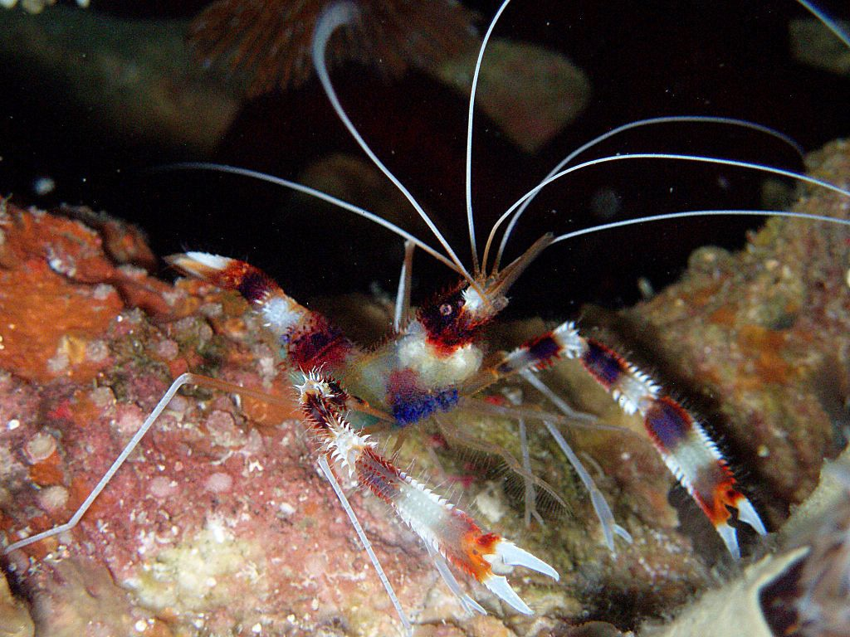
BANDED CORAL SHRIMP
White antennae often sticks out of the hiding hole
Live in cracks in the reef by day
Red and white stripes on body

Slide 6
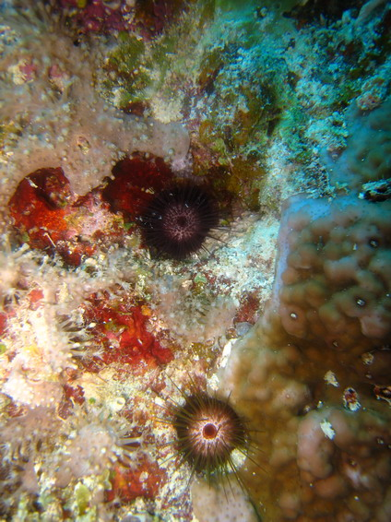
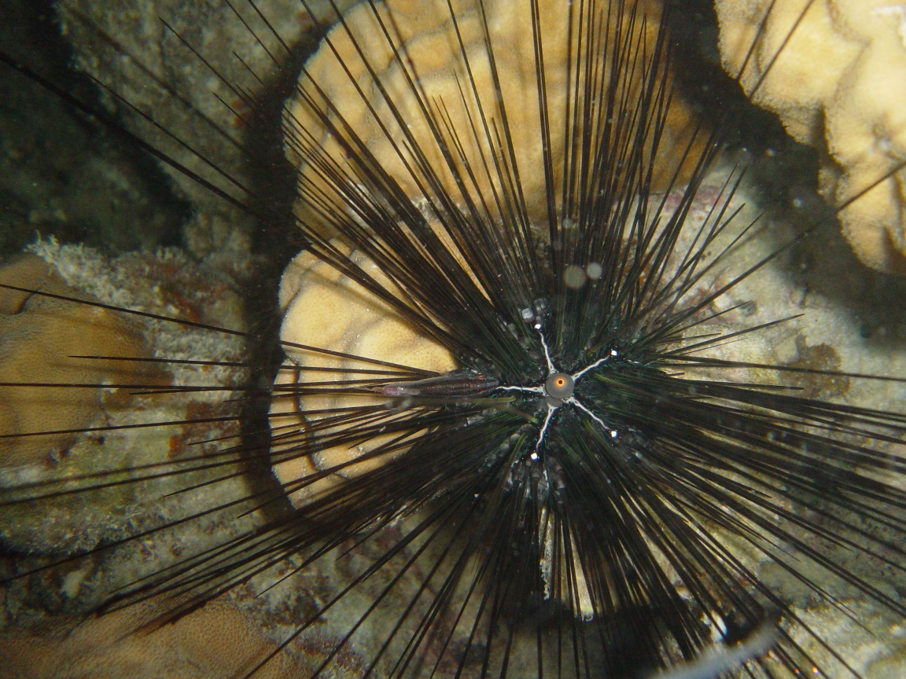
DIADEMA URCHIN
Black in color
Long, thin spines on the body
Some species burrow in rocks

Slide 7
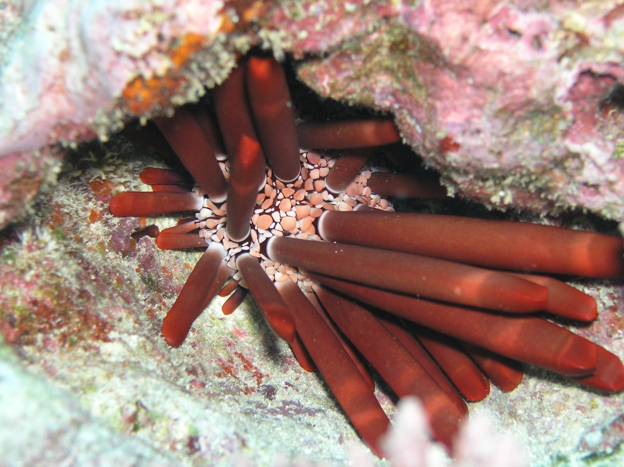
PENCIL URCHIN
Live in cracks and crevices
Thick, stubby spines
Spines are usually red in colour with a stripe near the point

Slide 8
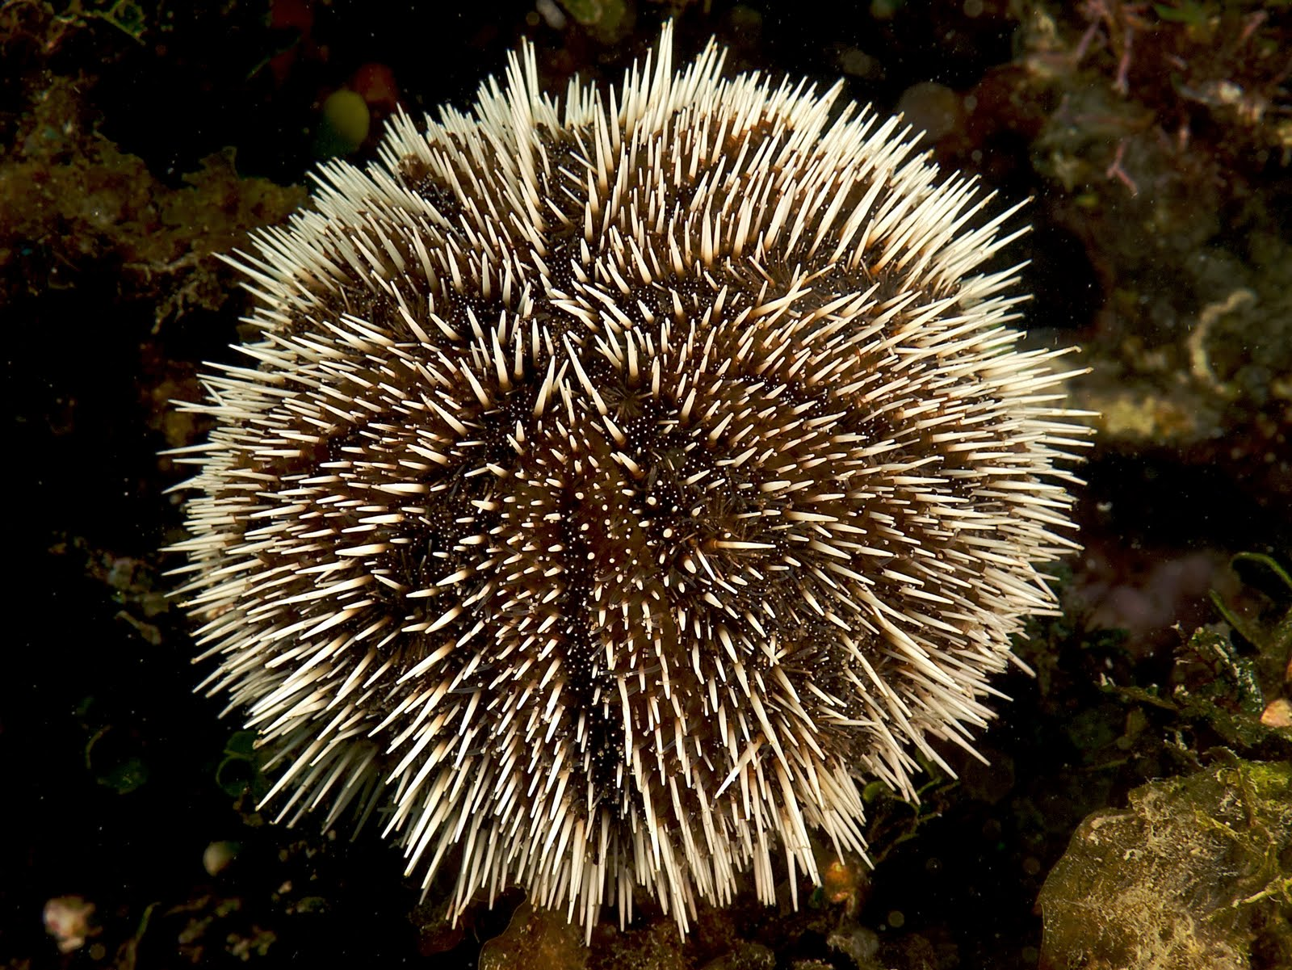
COLLECTOR URCHIN
Shape like an oval ball
Star-shaped ridge on top of its body
Short spines

Slide 9
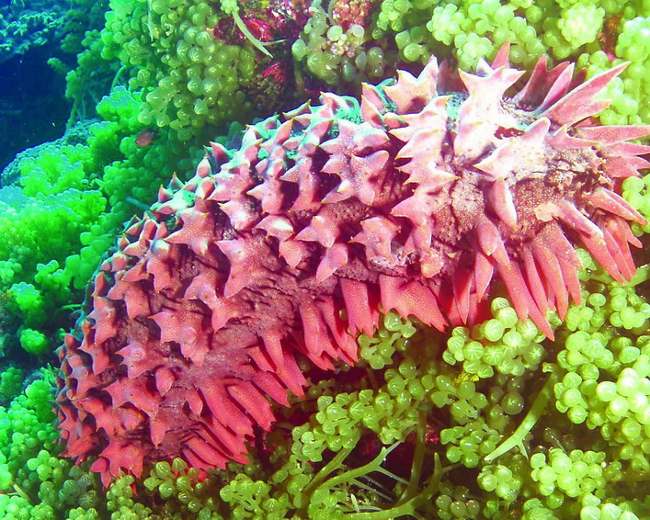
SEA CUCUMBER
There are three sea cucumbers that are included as Reef Check targets…
1
PRICKLY REDFISH
Shaped like an elongated pineapple
Red in colour
Spiky-looking papillae

Slide 10
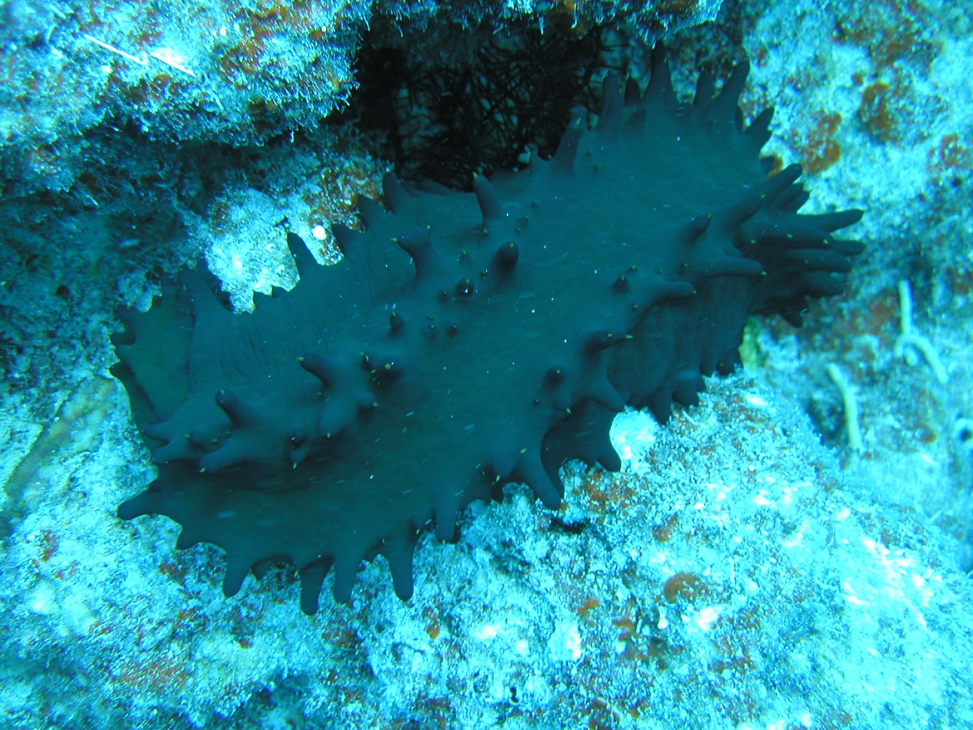
SEA CUCUMBER
There are three sea cucumbers that are included as Reef Check targets…
2
PRICKLY GREENFISH
Body shaped like a box / cube instead of round
Orange dot on every papillae tip
Row of papillae on every edge of the “box”

Slide 11
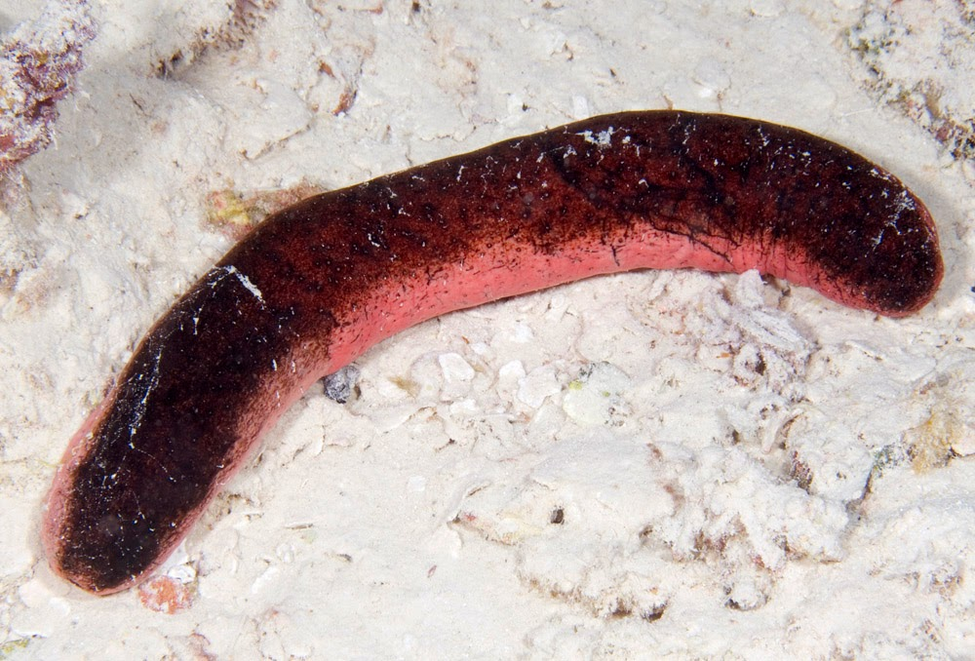
SEA CUCUMBER
There are three sea cucumbers that are included as Reef Check targets…
3
PINKFISH
Looks like sausage on your hotdog!!
Black on top,
pink on the underside

Slide 12
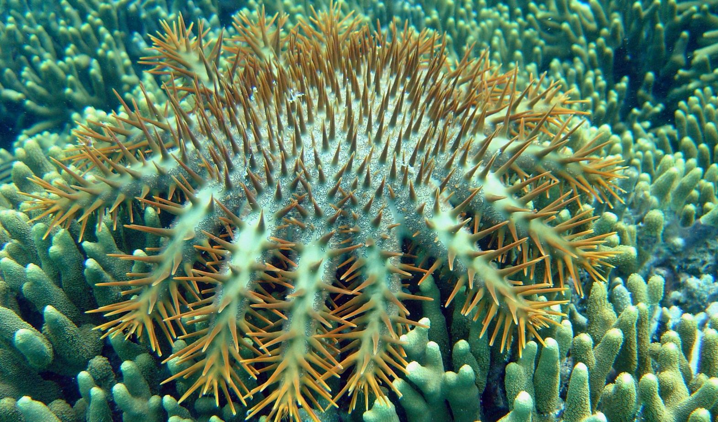
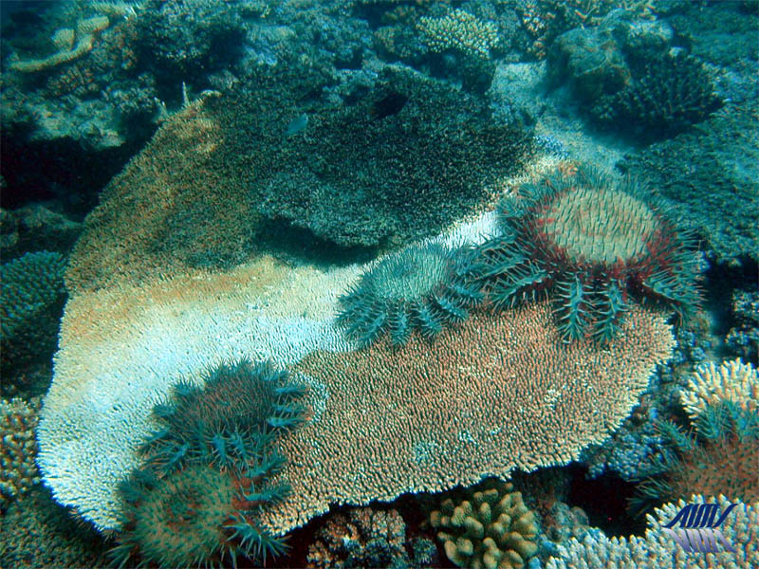
CROWN OF THORNS
Body covered in spikes containing venom
Look out for CoT scars!
Eat coral polyps
Multiple arms
(can be up to 21 arms)

Slide 13
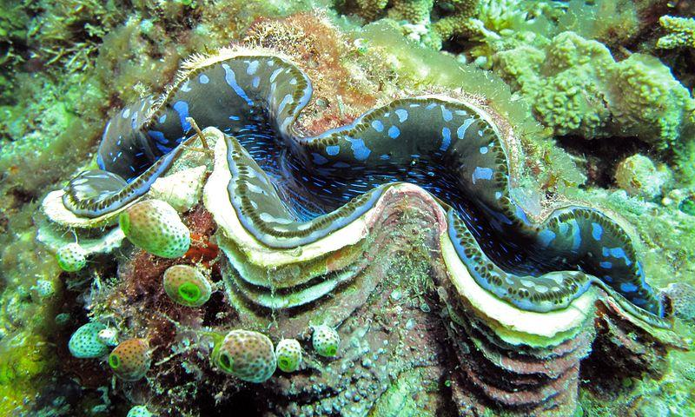
GIANT CLAM
Big, colourful lips
Very noticeable from the curves and color of the lips
Live burrowing themselves into hard corals / rocks

Slide 14
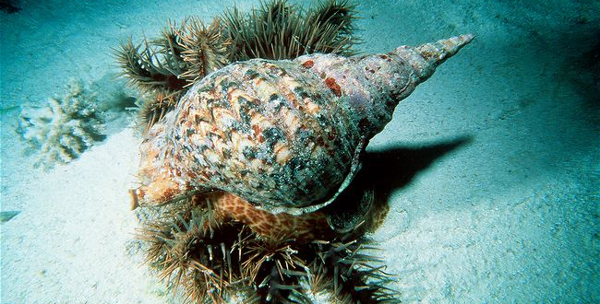
TRITON
Massive snail with spiral shell
Predator of Crown-of-Thorns

Slide 15
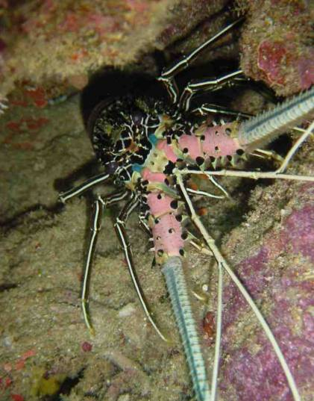
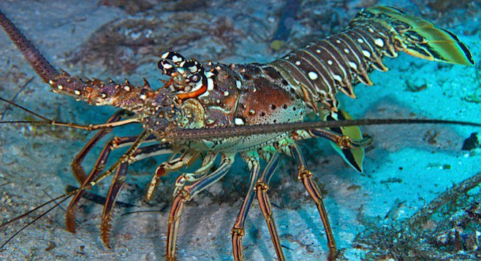
LOBSTER
Hide in cracks during the day
Spiny appendages usually stick out

Slide 16
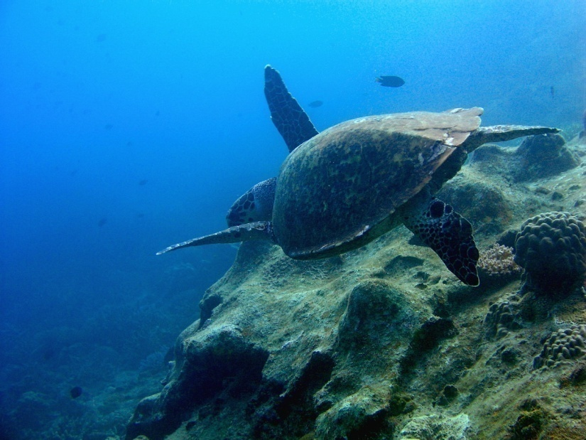
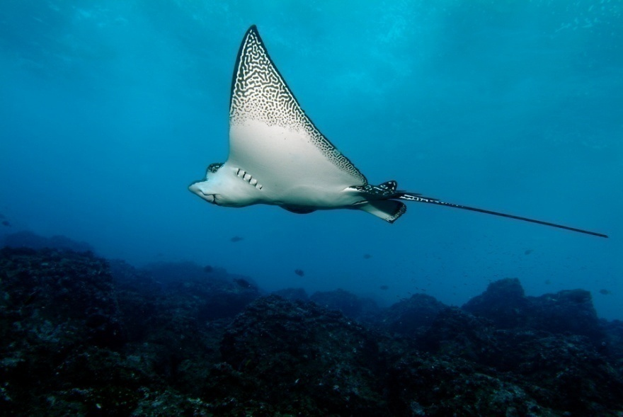
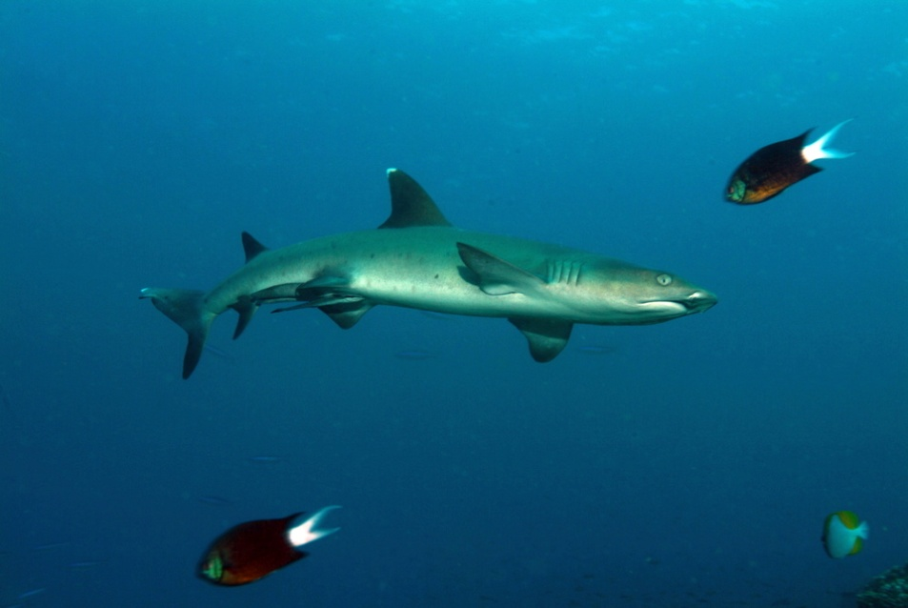
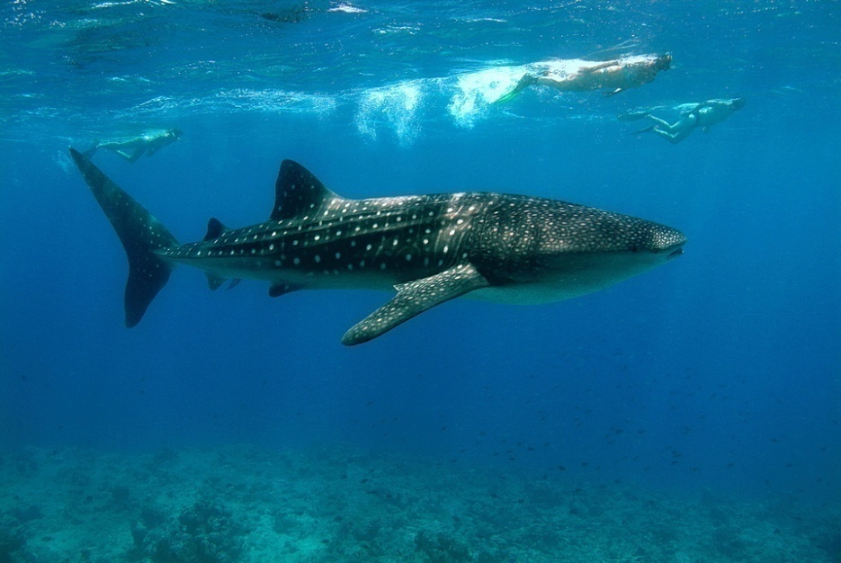
RARE ANIMALS
Note anything rare even if off-transect

Slide 17
STUDY WELL…
We will answer further questions you have on camp ☺
AND SEE YOU SOON! ☺

