Slide 1


REEF CHECK SUBSTRATES
Notes:
Eureka Amadea
May 2018

Slide 2

SUBSTRATE CATEGORIES
HC - Hard Coral
SC - Soft Coral
NIA - Nutrient Indicator Algae
SP - Sponge
OT - Other
RKC - Recently Killed Coral
RC - Rock
RB - Rubble
SI - Silt
SD - Sand

Slide 3
WAFT!!
The key to identify living substrates is to WAFT them and observe
WAFT = REACTION
Each substrate will give different reaction.
Non-living substrate won’t give any reaction.

Slide 4
HERE IT GOES…..

Slide 5
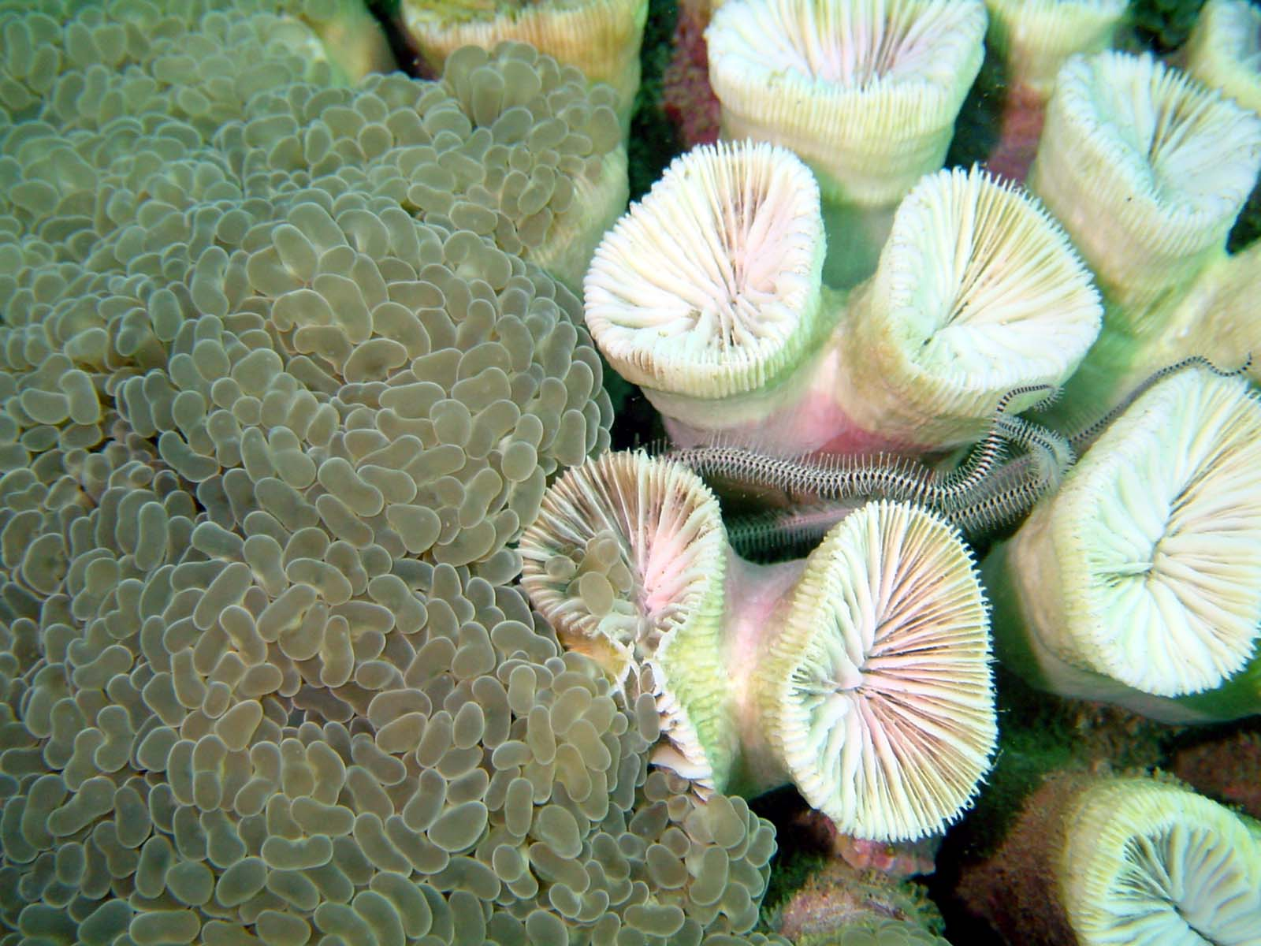
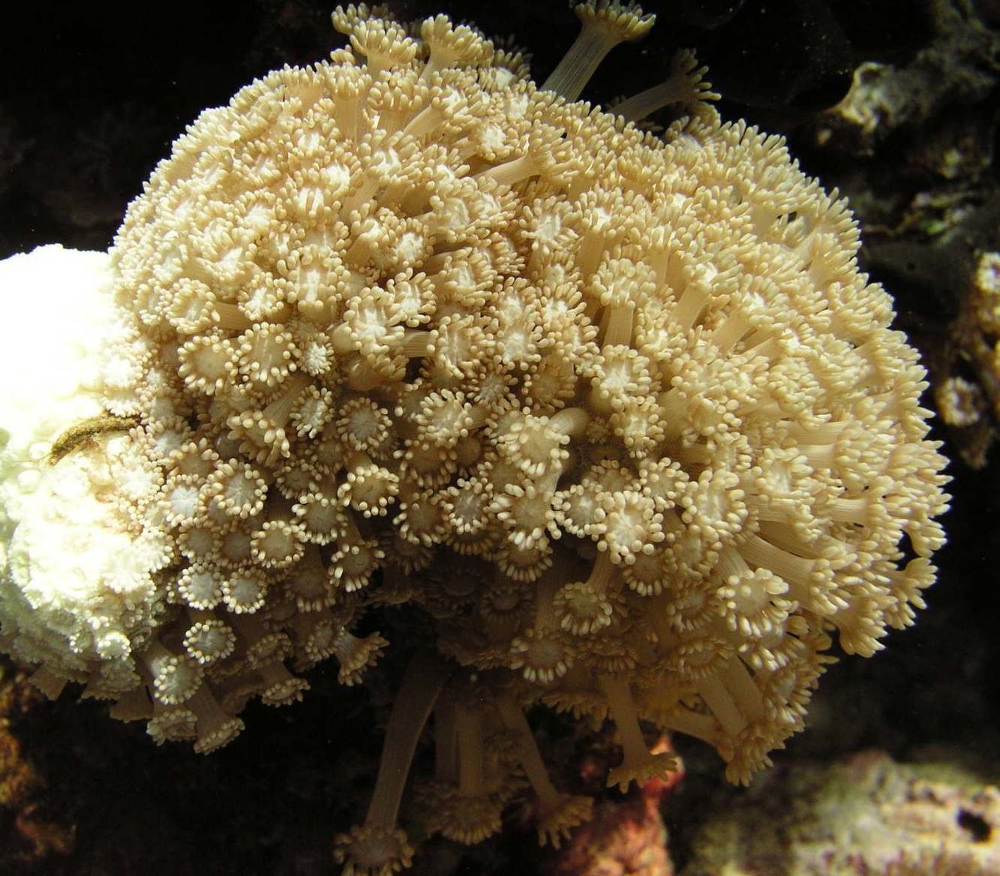
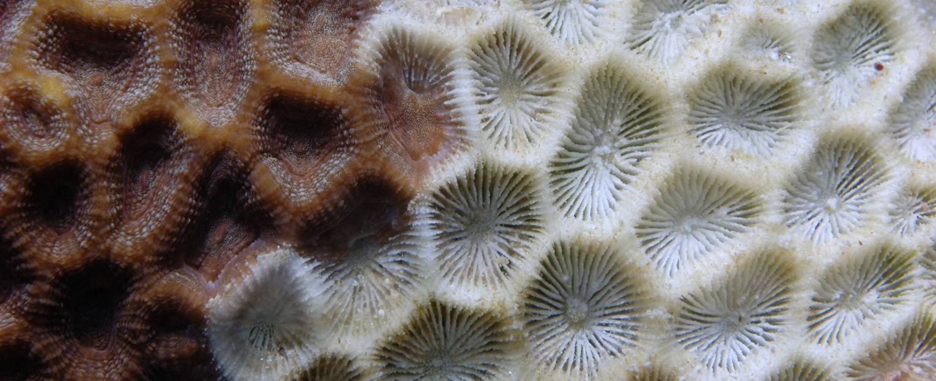
HARD CORALS
Limestone skeleton (white in color)
Colorful polyps sit on the coral cups
Some have bubble-like polyps
Have “corallites” / coral cups
Some have retractable tentacles
WAFT = NO REACTION / TENTACLES RETRACT / SHOWING HARD SKELETON

Slide 6
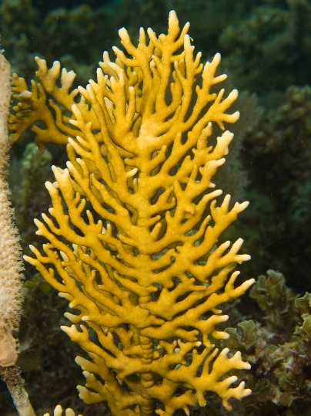
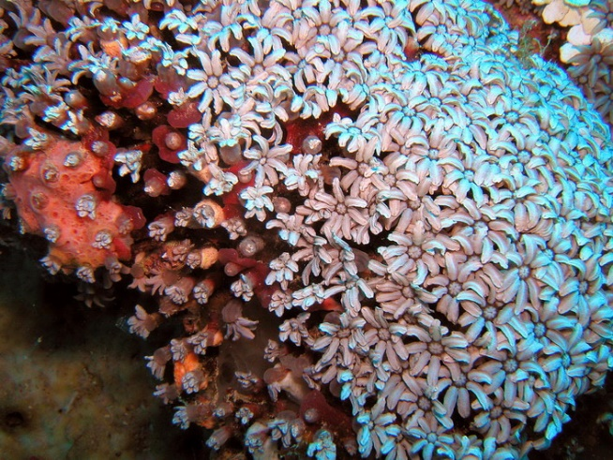
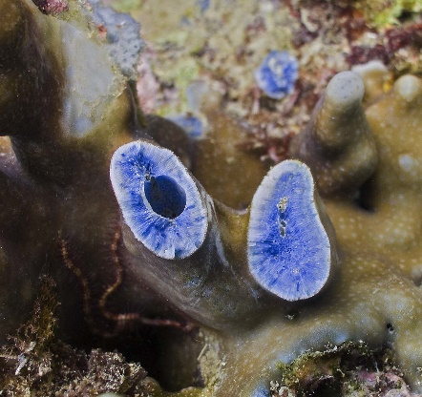
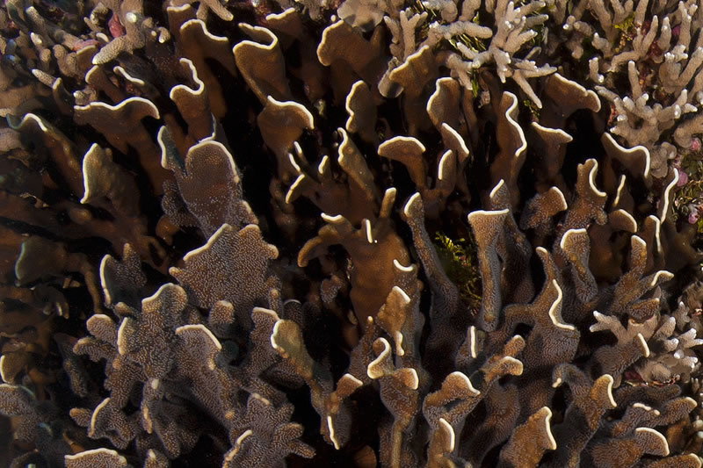
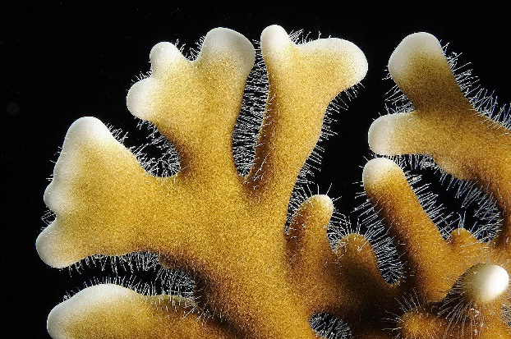
HARD CORALS
For Reef Check purposes, there are three corals that are technically NOT Hard Coral but contribute in reef building…
Blue Coral
Fire Coral
Organ Pipe
…and classified as “Hard Coral”
WAFT = NO REACTION / TENTACLES RETRACT / SHOWING HARD SKELETON

Slide 7
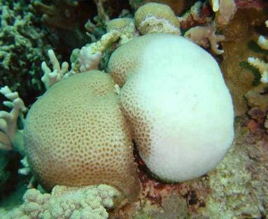
HARD CORALS
If a hard coral is bleached, but still alive…
…it is still classified as “Hard Coral”,
and just add a little “B” to indicate bleaching
“Hard Coral – B”
WAFT = NO REACTION / TENTACLES RETRACT / SHOWING HARD SKELETON

Slide 8
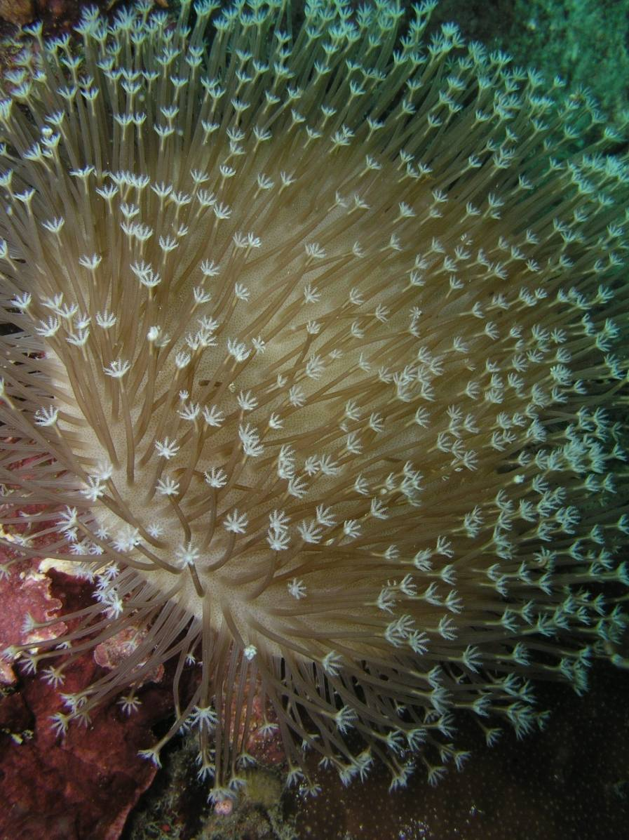
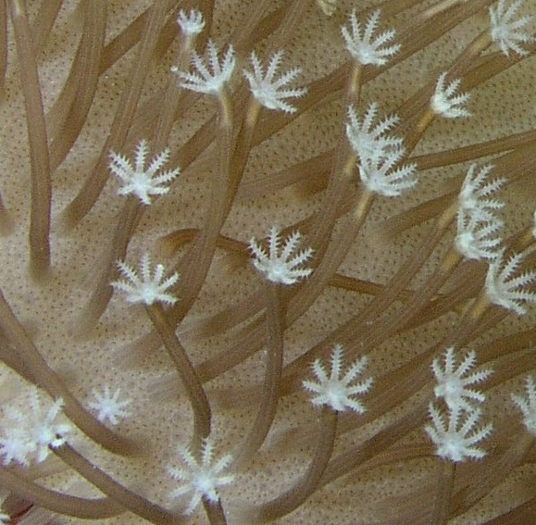
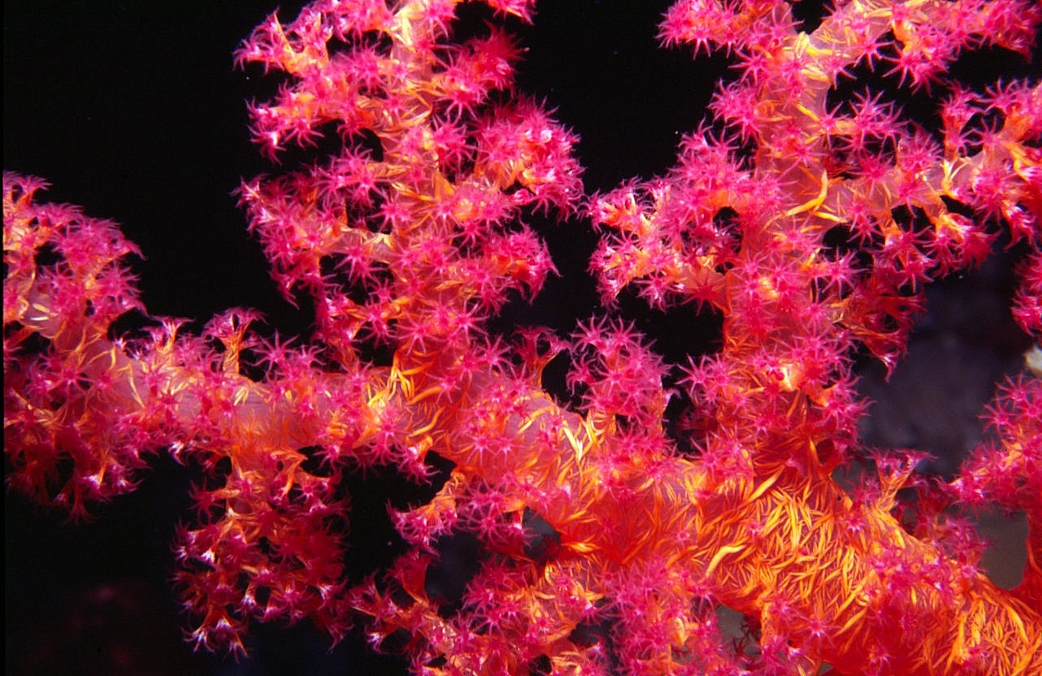
SOFT CORALS
Tentacles tend to be hairy or feathery
Have 8 tentacles
Often with bright colors
WAFT = WHOLE STRUCTURE MOVE / SWAY IN CURRENT

Slide 9
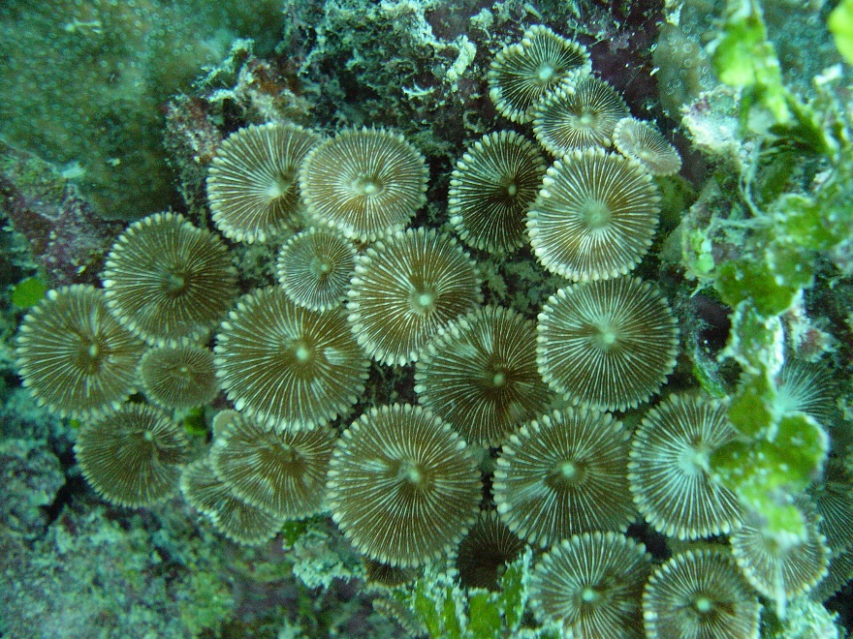
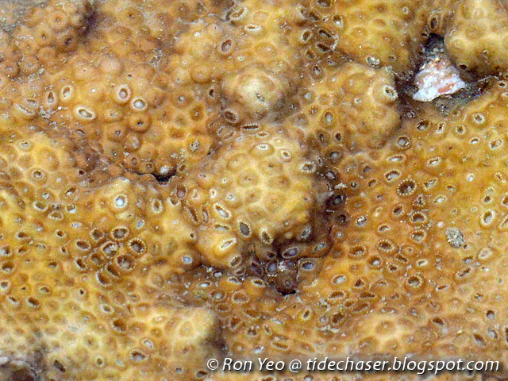
SOFT CORALS
You also have your zoanthids…
Solitary zoanthid
Colonial zoanthid
…which is included in “Soft Coral” category
WAFT = EDGES WILL CLOSE

Slide 10
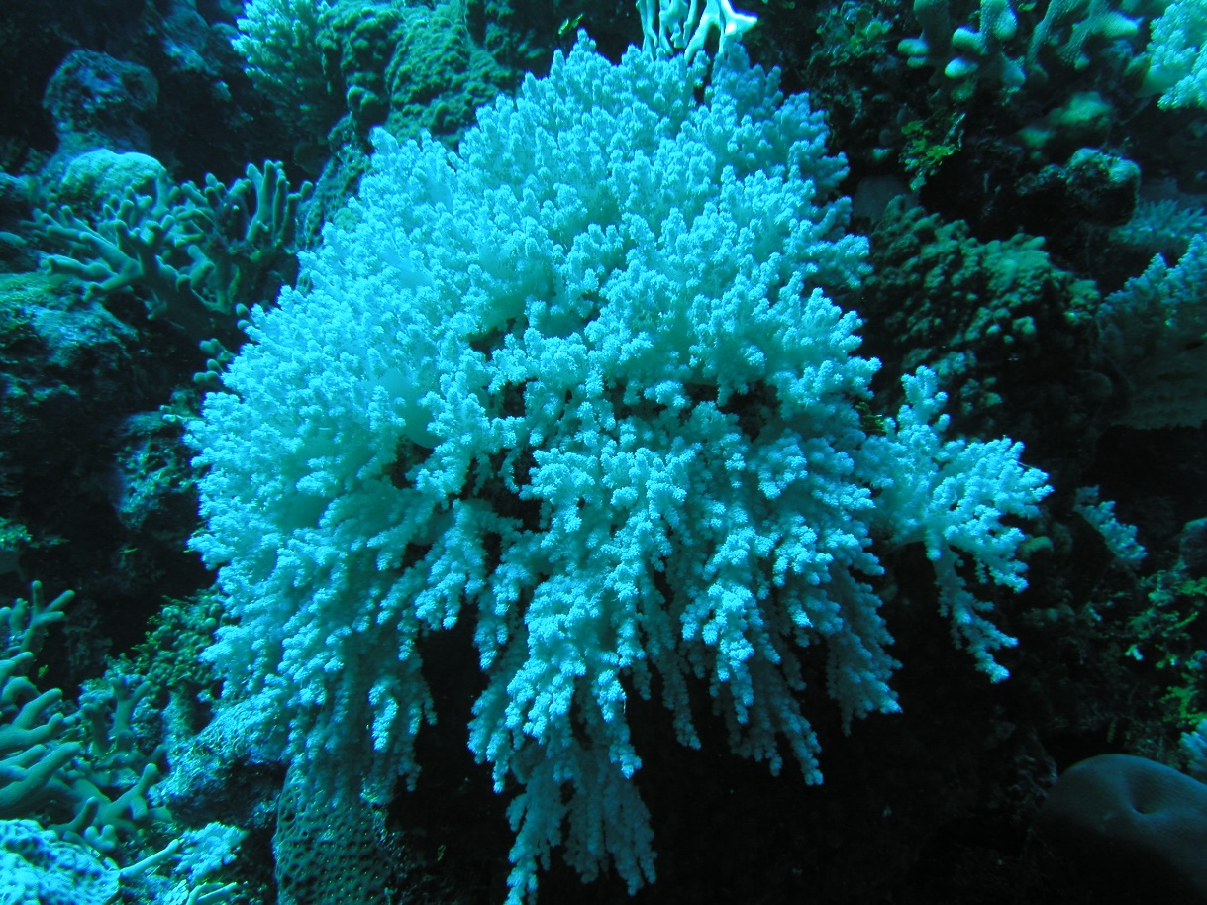
SOFT CORALS
Soft coral can also bleach, just like hard coral!
“Soft Coral – B”
WAFT = WHOLE STRUCTURE MOVE / SWAY IN CURRENT

Slide 11
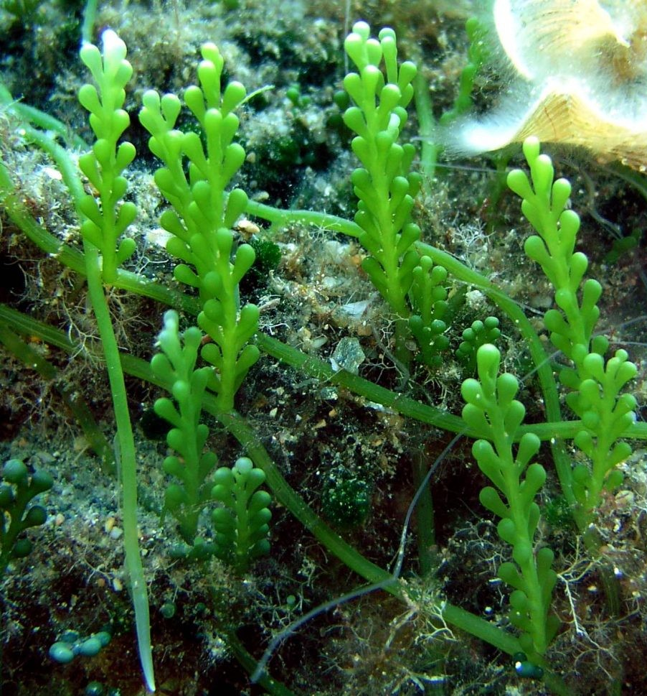
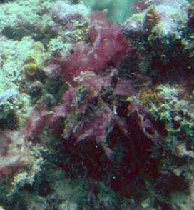
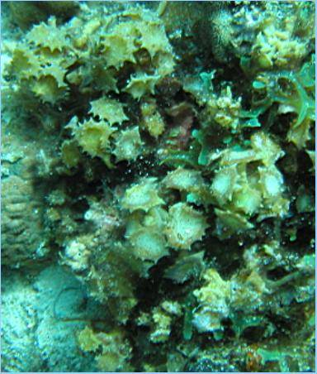
NIA: NUTRIENT INDICATOR ALGAE
Plant-like form
Can be green, red, or brown
Can be filamentous or hairy
Seems sticky or fleshy
Can have a shape like grapes
WAFT = SWAY ALONG

Slide 12
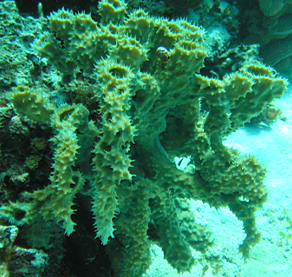
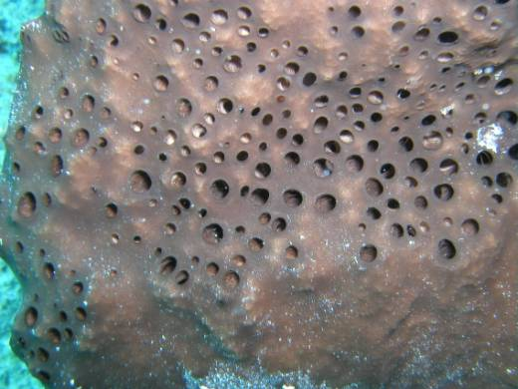
SPONGES
Some have spiky textures
Have one big hole to expel water
Dull coloration
Have irregular holes / pores all over its body
WAFT = SOME MOVE A BIT, HOLE STAYS OPEN

Slide 13
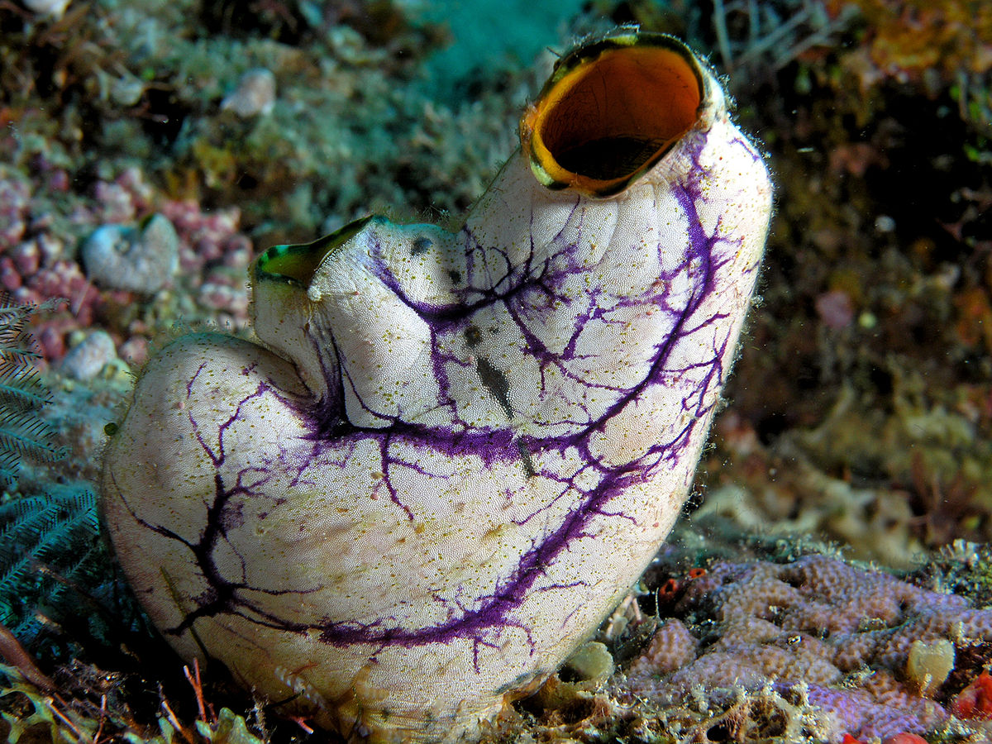
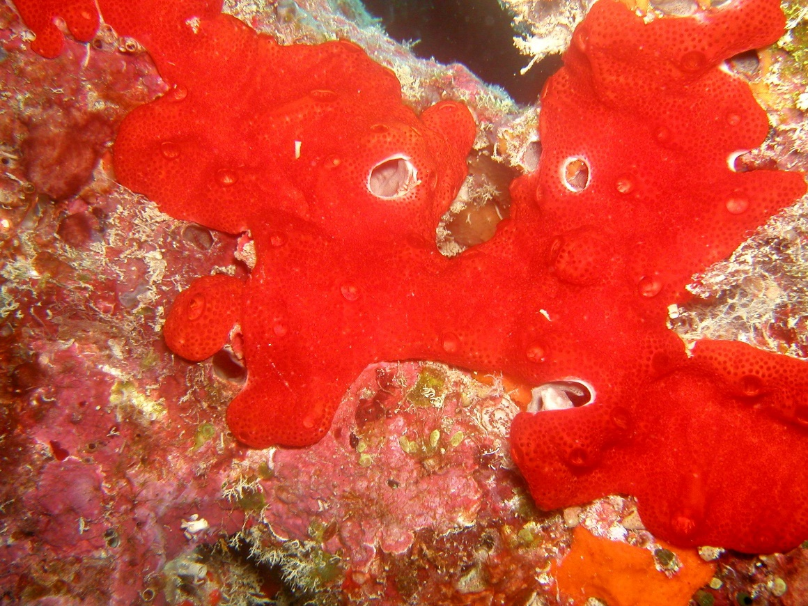
OTHER
There are several living animals that are included in “OTHER” categories…
TUNICATE
WAFT = HOLE WRINKLES AND CLOSES

Slide 14
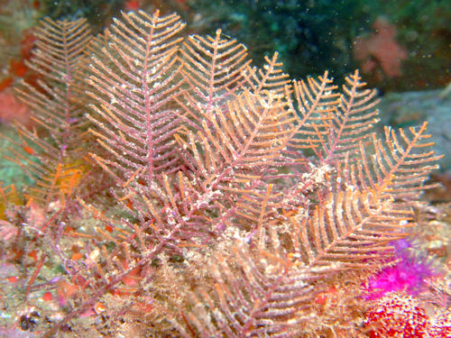
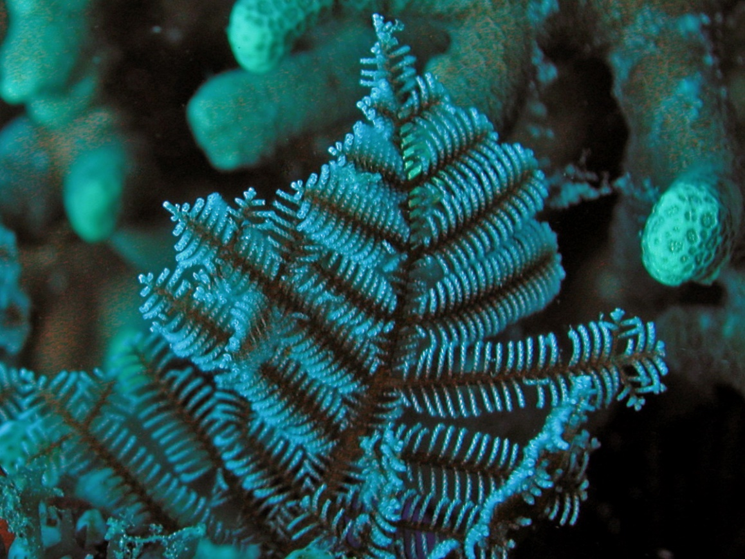
OTHER
HYDROIDS
They sting!!!
THEY’RE DISTINCTIVE AND DON’T NEED A WAFTING! ☺

Slide 15
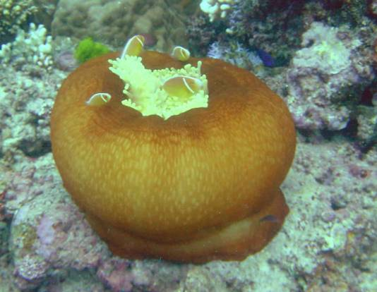
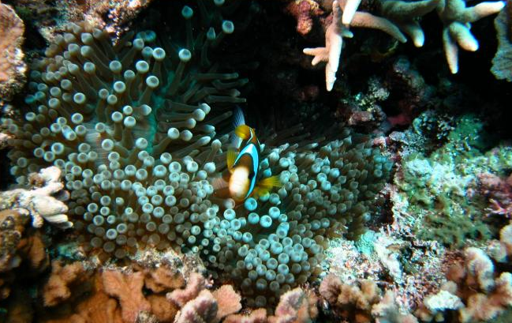
OTHER
ANEMONE
Tentacles often has bulbous tip
Often have clownfish living inside
WAFT = NO HARD STRUCTURE UNDERNEATH TENTACLES

Slide 16
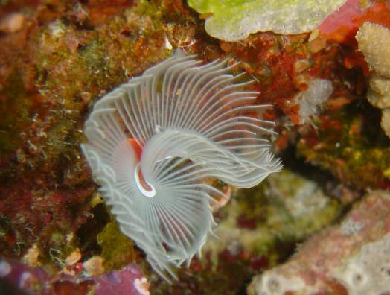
OTHER
TUBE WORM
Often found on hard corals or rocks
WAFT = RETRACT AND HIDE INTO CORALS / ROCK

Slide 17
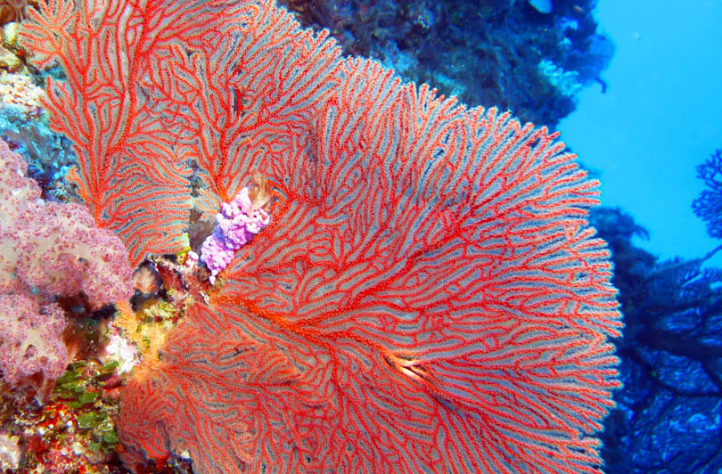
OTHER
SEA FAN
THEY’RE DISTINCTIVE AND DON’T NEED A WAFTING! ☺

Slide 18
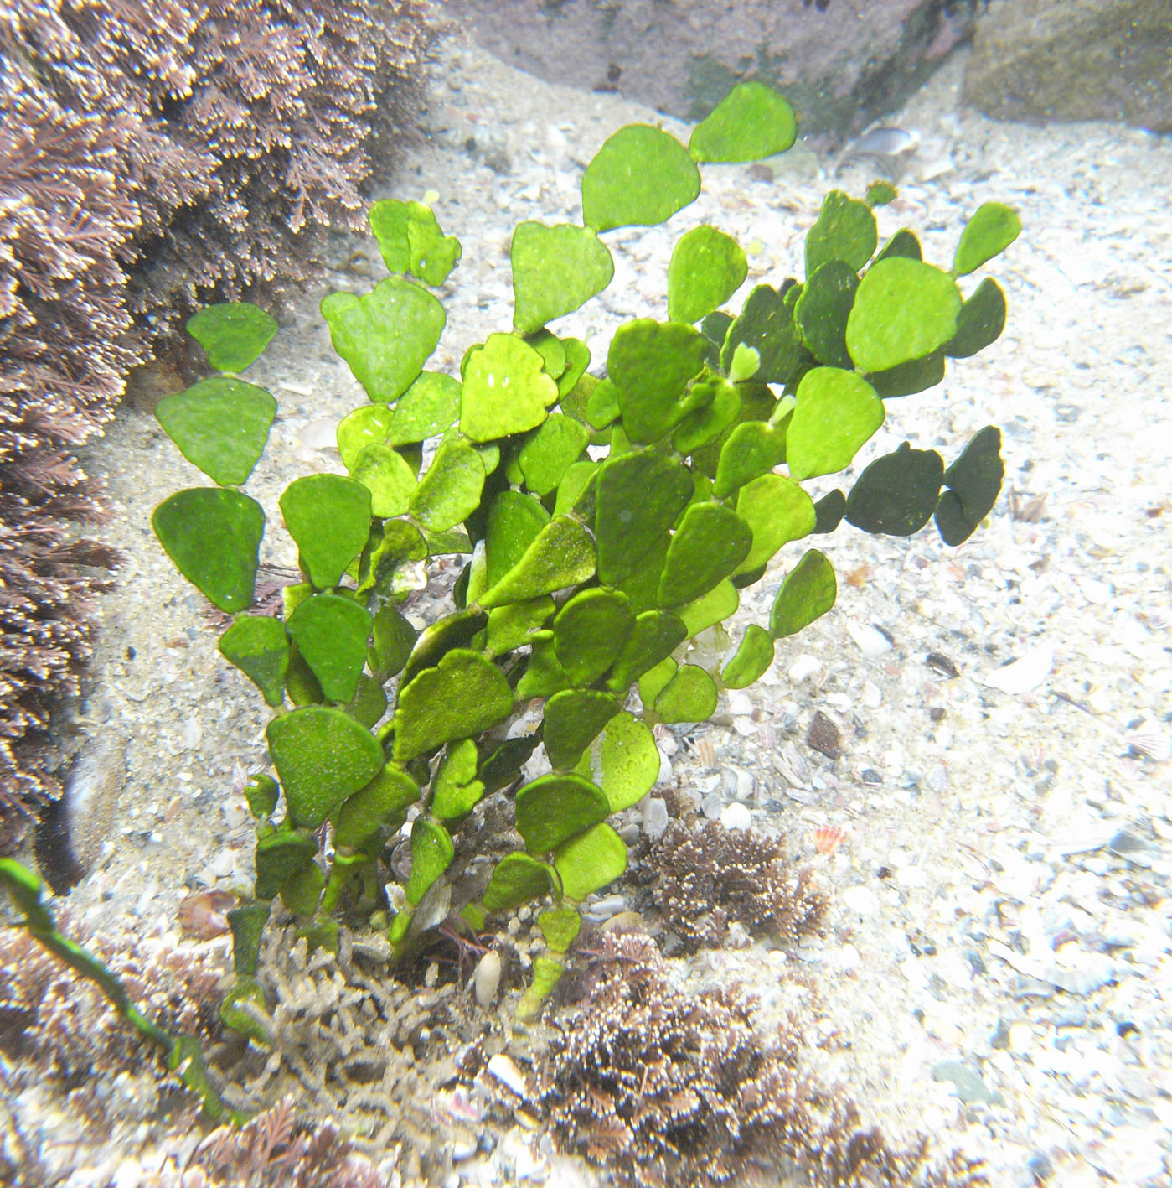
OTHER
HALIMEDA
THEY’RE DISTINCTIVE AND DON’T NEED A WAFTING! ☺

Slide 19
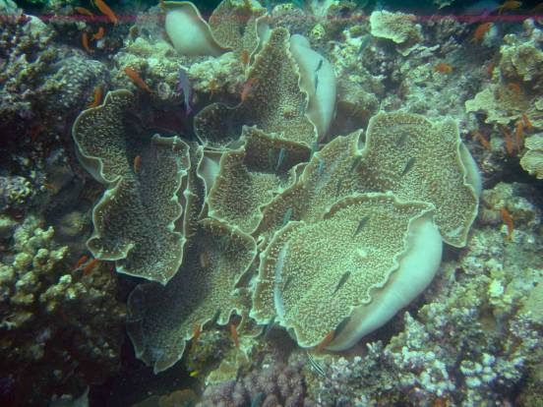
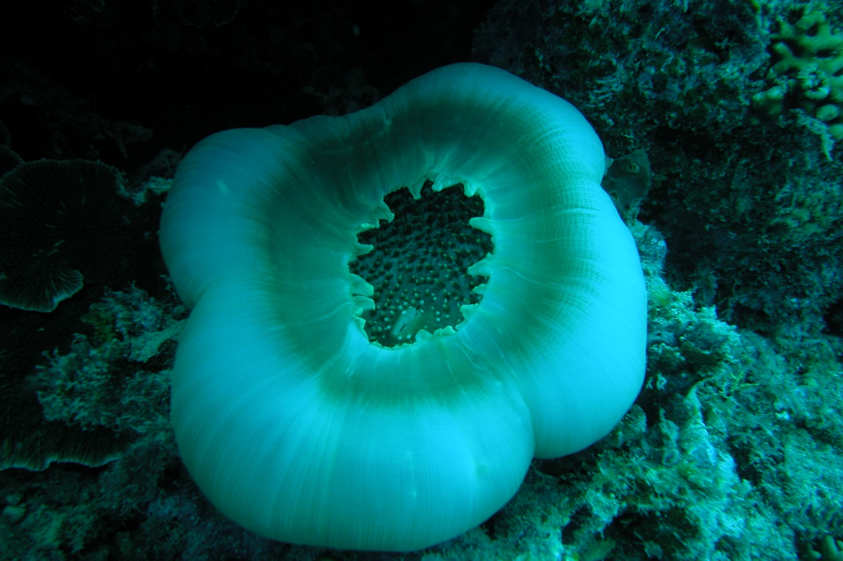
OTHER
CORALLIOMORPH
WAFT = THE SIDES WILL FLAP UP

Slide 20
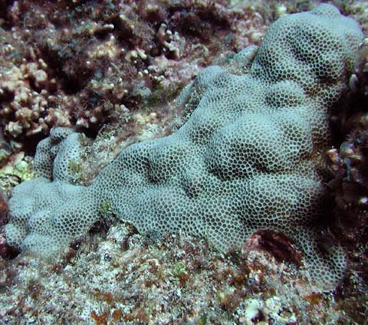
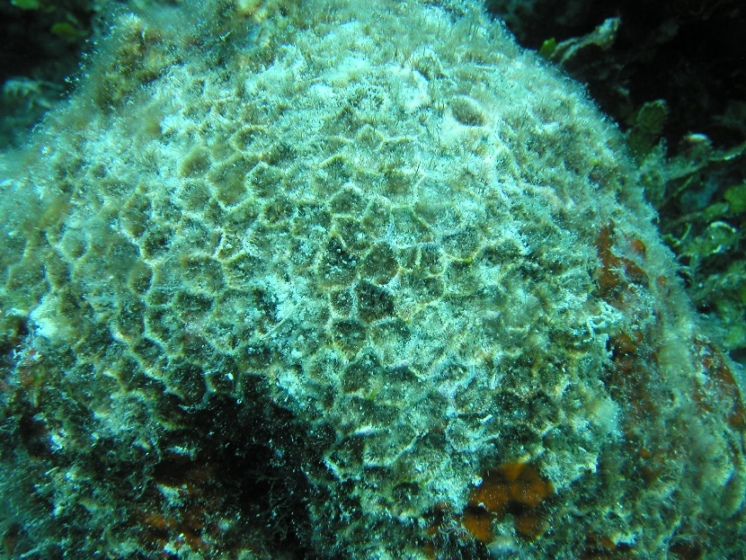
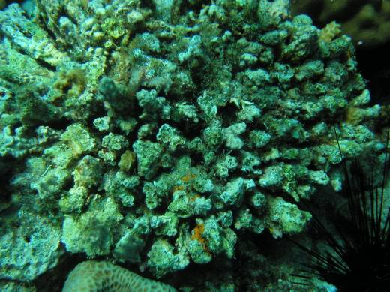
ROCKS
Hard substrate where corals can grow on
Dead corals with eroded skeleton = ROCK
Corals that are dead for a long time (covered in turf algae) = ROCK
WAFT = NOTHING HAPPENS

Slide 21
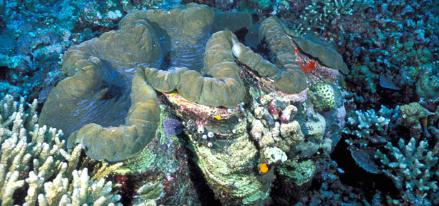
ROCKS
All sorts of things can grow on your giant clam’s shell…
…therefore they’re also recorded as “ROCK”
WAFT = NOTHING HAPPENS

Slide 22
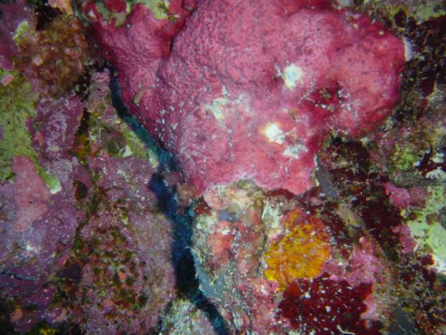
ROCKS
Coralline algae covers rock and help things grow by acting as glue…
Red like paint
…therefore they’re also recorded as “ROCK”
WAFT = NOTHING HAPPENS

Slide 23
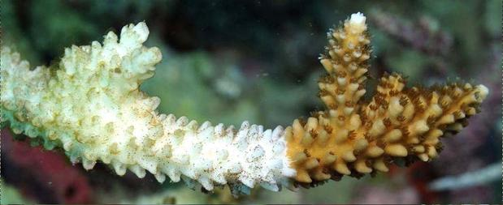
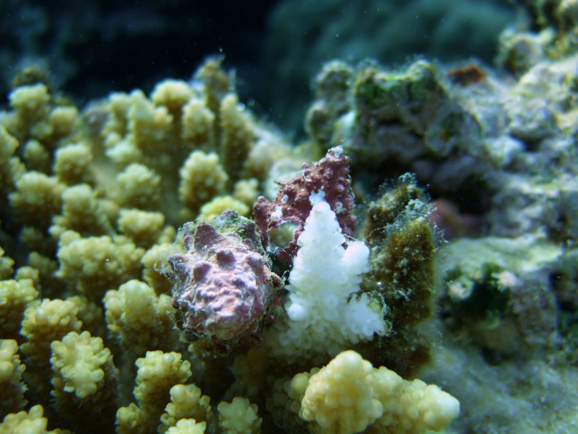
RECENTLY KILLED CORAL
White skeleton showing without no more tissue attached
White skeleton showing as a result of predation
Covered by tiny layer of algae
WAFT = NOTHING HAPPENS

Slide 24
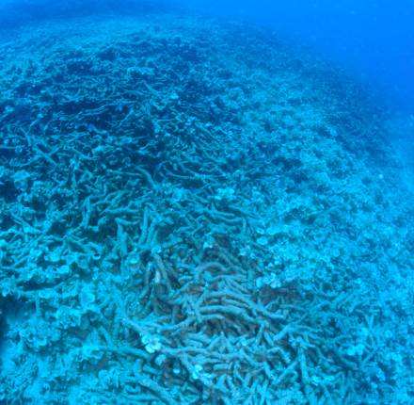
RUBBLES
Pieces of rock
WAFT = NOTHING HAPPENS

Slide 25
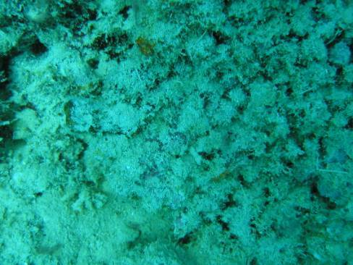
SILT
Layer looks thick like a blanket
Often creates layer on top of other substrates
WAFT = RISE AND CREATE SUSPENSION / CLOUDY

Slide 26
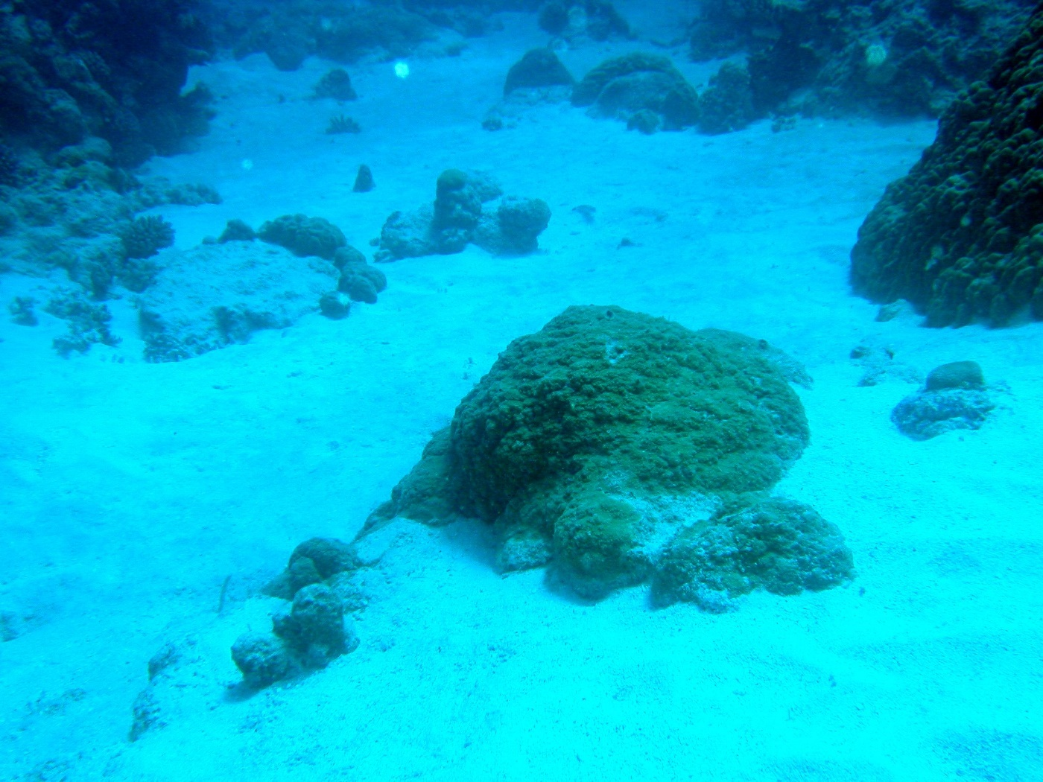
SAND
Visible grains
Often found in patches
WAFT = RISE AND SETTLE DOWN IMMEDIATELY

Slide 27
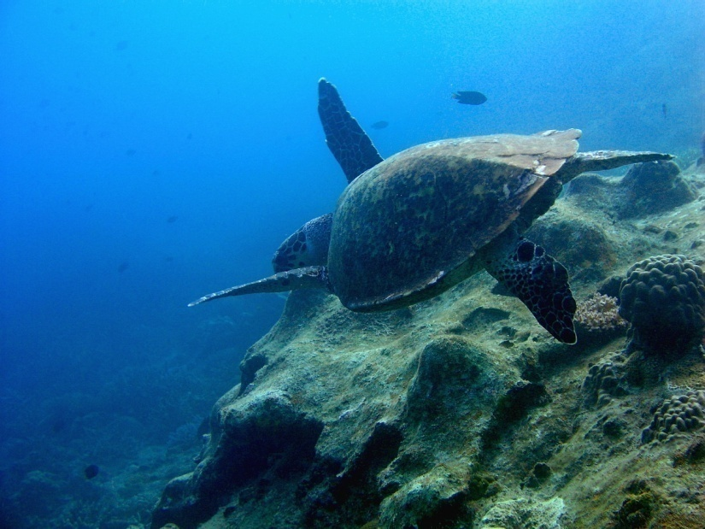
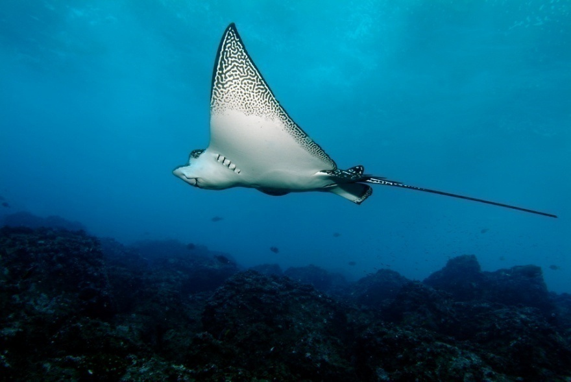
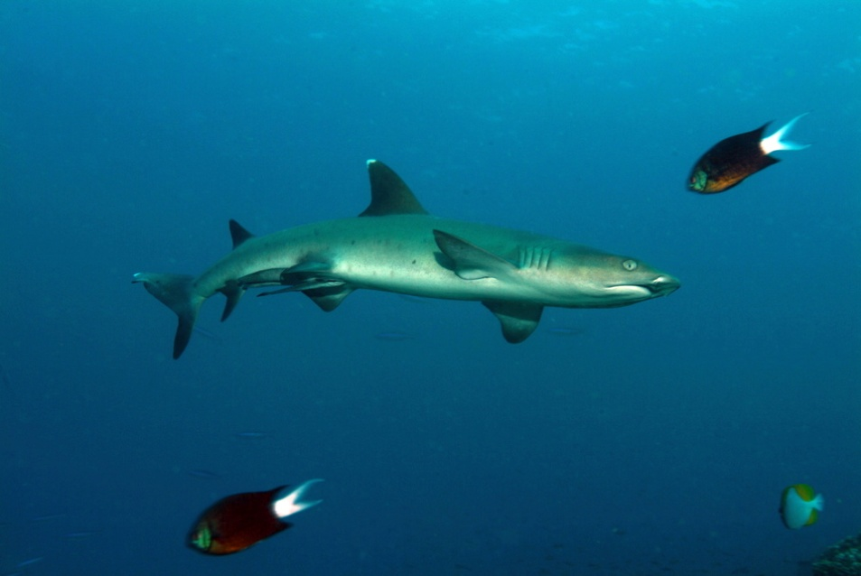
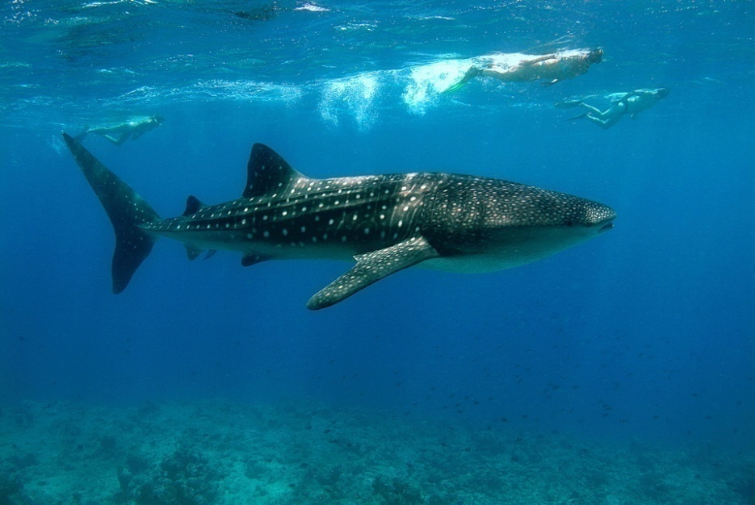
RARE ANIMALS
Note anything rare even if off-transect

Slide 28
STUDY WELL…
We will answer further questions you have on camp ☺
AND SEE YOU SOON! ☺

